Slide 1

PROJECT-2
DATA ANALYSIS OF
2016 BC HOUSING AFFORDABILITY AND RENTAL SUBSIDIES
USING PYTHON

Slide 2

INTRODUCTION TO BC CENSUS 2016 DATA
The BC Census 2016 data project provides a comprehensive analysis of demographic and socio-economic trends in British Columbia. By leveraging this data, the project aims to inform policy decisions and enhance understanding of community needs.

Slide 3

PLATFORMS USED FOR THIS PROJECT
PYTHON
MATPLOTLIB
PANDA

Slide 4
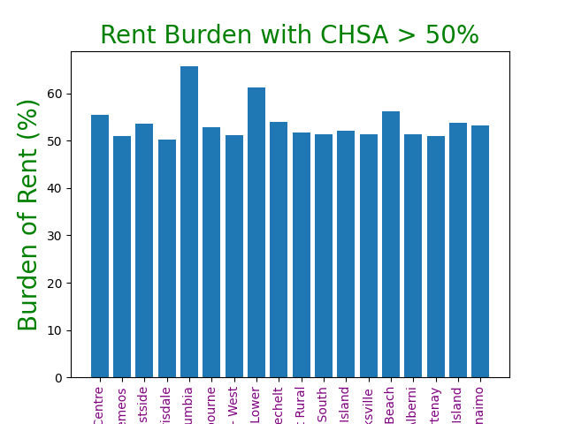
HOUSING PRICING COMPARISON
FROM THE BAR CHART SHOWN, BRITISH COLUMBIA HAS THE HIGHEST HOUSING COST AS COMPARED TO OTHER CITIES !!!

Slide 5
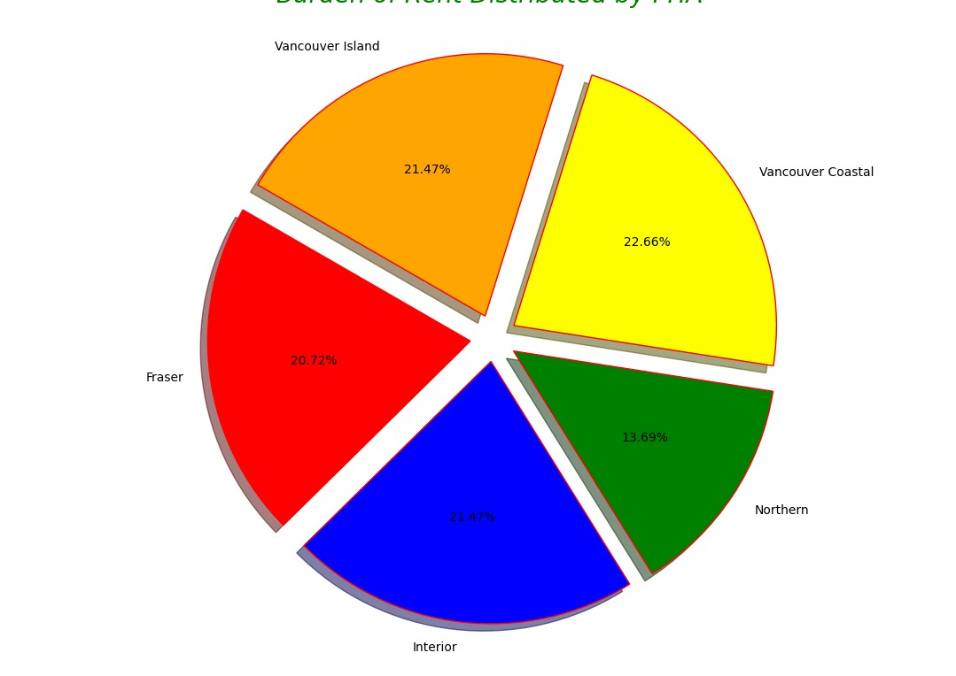
HOUSING DISTRIBUTIONS
THIS PIE CHART SHOWS HOW HOUSING CONDITIONS ARE DISTRIBUTED AMONG VARIOUS REGIONS !!

Slide 6

CODING USED FOR BAR CHART
plt.figure()
plt.bar(high_rent["chsa"], high_rent["shelt_rent_30plus_rate"])
plt.title("Rent Burden with CHSA > 50%", color= 'green', fontsize=20)
plt.xlabel("CHSA", color= 'green', fontsize=20)
plt.ylabel("Burden of Rent (%)", color= 'green', fontsize=20)
plt.xticks(rotation=90, color= 'purple')
plt.show

Slide 7

CODING USED FOR PIE CHART
plt.pie(
avg_region,
colors=colors,
explode=explode,
labels= avg_region.index,
autopct='%2.2f%%',
startangle=150,
shadow=True,
wedgeprops={'edgecolor': 'red'}
)
plt.tight_layout()
plt.title("Burden of Rent Distributed by PHA ",
fontsize=20,
fontstyle='oblique',
color= 'green'
)

Slide 8
KEY OUTCOMES
Python helps visualize data clearly.
Housing affordability is a major issue.
Data supports decision-making

Slide 9

THANK YOU
ANY QUESTIONS?

